Slide 1


Today we are going to talk about Digital safety. Just like we try to be safe in real life, like looking both ways before crossing the street, we need to be safe online as well!
We all have a right to feel safe and secure and that means to be kept safe online as well as in the real world. Our lessons promotes safe, responsible and positive use of the internet.

Slide 2


ARTICLES – What do they mean for you?
Article 17, Access to information from the media - Every child has the right to reliable information from a variety of sources and governments should encourage the media to provide information that children can understand. Governments must help protect children from materials that could harm them.
Article 19, Protection from violence, abuse and neglect - Governments must do all they can to ensure that children are protected from all forms of violence, abuse, neglect and bad treatment by their parents or anyone else who looks after them.

Slide 3
https://admin.base.education/#/organizations/o_e36075e4_565c_4cb5_bb55_f2168e12a76d/courses
What was the main message from the BASE video?
What does safety online mean to you?
What does ‘etiquette’ mean? How can this impact others?
(manners and norms- which are understood ways we behave in our society.)

Slide 4
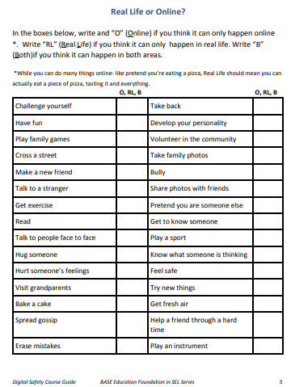

Slide 5
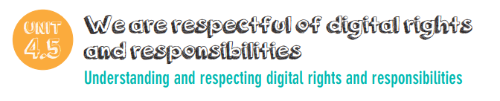
In this online safety session you are going to develop the idea of what makes a good digital citizen.
As you have got older and developed more skills, you need to review what a good digital citizen now looks like, as you use the digital world more and more.

Slide 6
What makes you good digital citizens?
How can we all make sure that we are kept safe online and have access to all of our rights?
using technology safely,
sharing devices at school,
Being respectful online
making time for activities that do not require technology,
sharing their knowledge about internet safety with their families and friends.

Slide 7
Article 13
‘…all children have the right to freedom of expression. Every child must be free to say what they think and to seek and receive all kinds of information, as long as it is within the law.’

Slide 8
Article 16:
‘…every child has the right to privacy. The law should protect the child’s private, family and home life.’
How does these articles relate to online safety?
How can these articles help us in our daily lives?

Slide 9
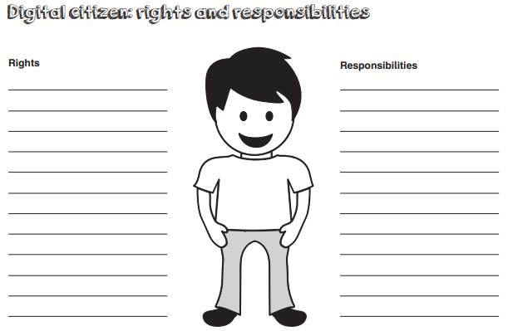

Slide 10
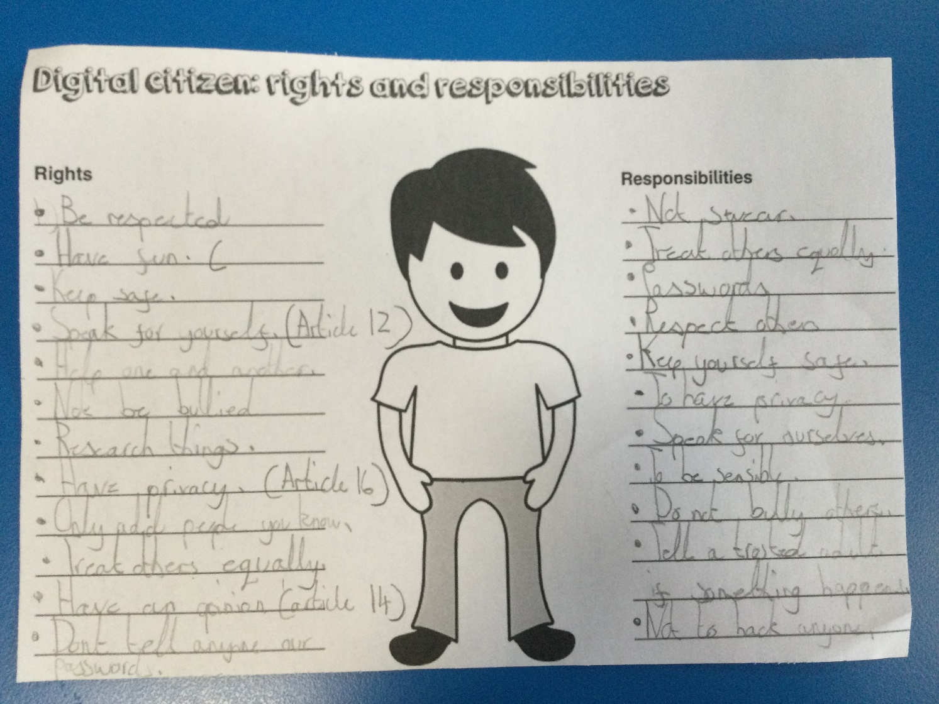
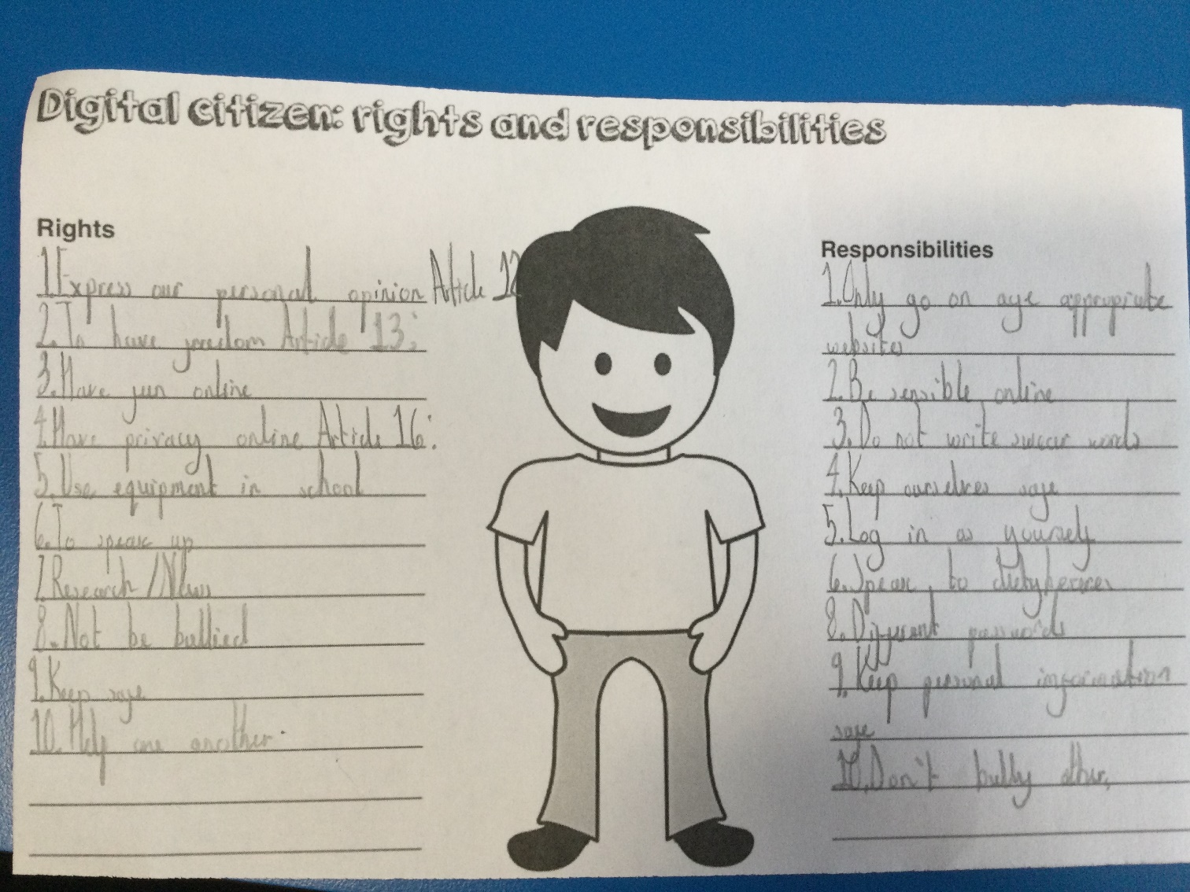
Pupil work:

