Slide 1
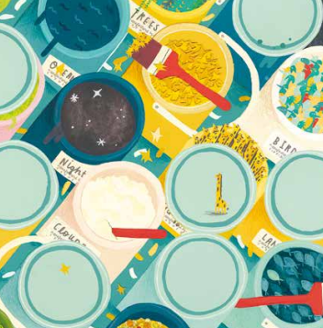
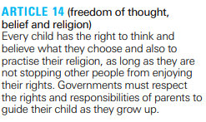

Wednesday 8th February 2023
L.O. How well are humans responding to their responsibility to care for the Earth?
Notes:
Refer to the articles
What are your initial thoughts towards this question? They might link to different topics covered in Science, Geography and History.
Do you think Science and Christianity would differ in their beliefs towards how humans should care for the Earth - what have we already learnt that could help us to consider this?
Do you think Science and Christianity would conflict or complement for this topic? Rather than seeing scientific accounts and Genesis as being in conflict, there are many Christians who see them as complementary. One simple explanation offered by many Christians is that science addresses how questions about the universe, its origins and mechanisms, whereas religion — in this case, Christian belief in a Creator — addresses why questions: why is there a universe at all? Why do humans matter?

Slide 2
Our Christian Vision:
‘You must love one another as I have loved you.’ John 13 v 34.
Our vision and Christian ethos is supported by the following core values:
•Forgiveness and Reconciliation
• Agape
• Compassion and Community
• Equality
• Service and Stewardship
Notes:
How do you think our school’s christian ethos could help us to think about this question? - how we treat the planet so that the future generations have it - also their are indigenous people or people in third world countries who are suffering because of what we have done to the world (in particular the sea levels) and so we should love them and help them - but also God ahs loved us by giving us this planet and we should treat it well.
Which value do you think we will focus on today? Stewardship - The term stewardship means to look after the world for God. God has created a world in which humans have a special role as stewards of creation. This means they should look after the interests of the planet and all life on it. This belief is more about living in harmony with nature.
When God gave humans dominion over the land, he gave them responsibility too. Humans were created to be stewards of the land, ie:
to use it
to look after it
to protect it

Slide 3
Key vocabulary:
Responsible - means being dependable, making good choices, and taking accountability for your actions. A responsible person would understand that we all have a part to play in making the world a better place.
Harmony - living together or existing peacefully.
Stewardship - the responsibility that Christians have in maintaining and using wisely the gifts that God has bestowed.

Slide 4
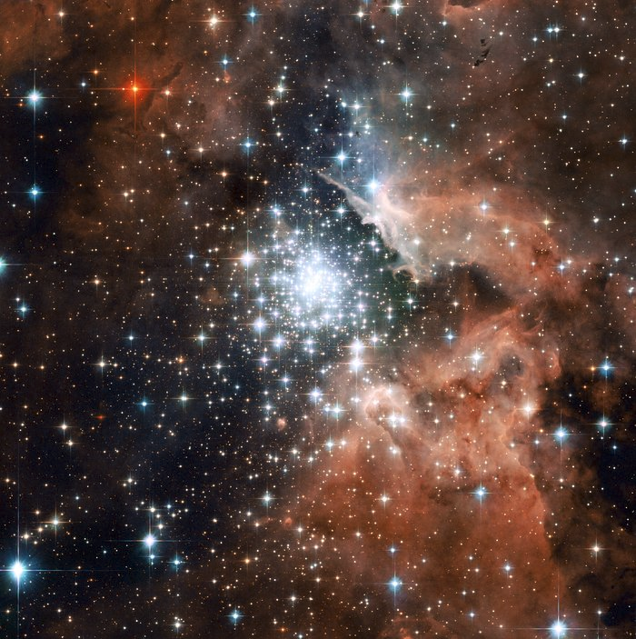
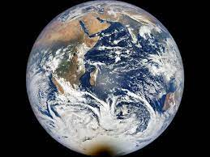
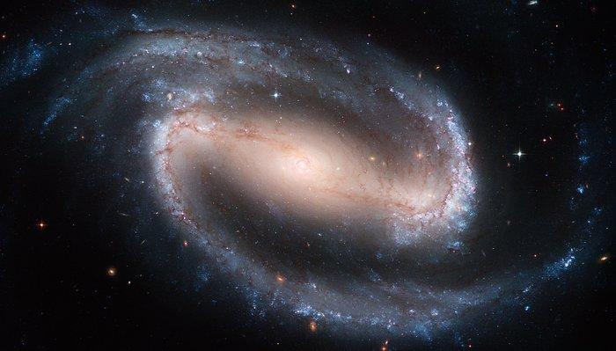
TTYP: How do you feel looking at the images?
Notes:
Extreme star cluster bursts into life in new Hubble image | ESA/Hubble (esahubble.org)
A poster-size image of the beautiful barred spiral galaxy NGC 1300 | ESA/Hubble (esahubble.org)
https://www.google.co.uk/url?sa=i&url=https%3A%2F%2Fwww.nasa.gov%2Ffeature%2Famazing-earth-satellite-images-from-2021&psig=AOvVaw35RtUriFcP0gybtJZHSQri&ust=1675507415889000&source=images&cd=vfe&ved=0CAwQjRxqFwoTCKDFoNeV-fwCFQAAAAAdAAAAABAH

Slide 5
TTYP: How do you feel looking at the images?
How often do you stop and appreciate how amazing the Earth is?
Notes:
Extreme star cluster bursts into life in new Hubble image | ESA/Hubble (esahubble.org)
A poster-size image of the beautiful barred spiral galaxy NGC 1300 | ESA/Hubble (esahubble.org)
https://www.google.co.uk/url?sa=i&url=https%3A%2F%2Fwww.nasa.gov%2Ffeature%2Famazing-earth-satellite-images-from-2021&psig=AOvVaw35RtUriFcP0gybtJZHSQri&ust=1675507415889000&source=images&cd=vfe&ved=0CAwQjRxqFwoTCKDFoNeV-fwCFQAAAAAdAAAAABAH

Slide 6
TTYP: How do you feel looking at the images?
How often do you stop and appreciate how amazing the Earth is?
Do you think if we reflected on this feeling more regularly, it would have an affect on how people treat the Earth?
Notes:
Extreme star cluster bursts into life in new Hubble image | ESA/Hubble (esahubble.org)
A poster-size image of the beautiful barred spiral galaxy NGC 1300 | ESA/Hubble (esahubble.org)
https://www.google.co.uk/url?sa=i&url=https%3A%2F%2Fwww.nasa.gov%2Ffeature%2Famazing-earth-satellite-images-from-2021&psig=AOvVaw35RtUriFcP0gybtJZHSQri&ust=1675507415889000&source=images&cd=vfe&ved=0CAwQjRxqFwoTCKDFoNeV-fwCFQAAAAAdAAAAABAH

Slide 7
TTYP: Do you think there is a connection between this experience and how reading Genesis 1 might inspire Christians to care for the Earth?
Notes:
Can you remember what happened in genesis? Why might this change how Christians care for the Earth? - because God made the world for them and he gave it to them to look after and therefore they would want to look after it and be responsible but also they would want future christians to also experience the wonderful earth that God has given us
Can refer back to the Genesis quote - the word ‘rule’ - do you think this means that humans can take whatever they want from the Earth for their own benefit and they have complete say? Do you think this means we have complete control over other living beings? What would the consequences of thinking like this be?
To challenge these ideas, Christians have turned to the second creation account in Genesis 2. In verse 15, humans were placed in the Garden of Eden and instructed to ‘work it and take care of it’. In other words, God has given us the responsibility to act as stewards of his creation – to care for, manage, oversee and protect all that God owns. What an honour and privilege!

Slide 8
Psalm 8
How might this passage make Christians feel about God, the world, themselves and other creatures?
How does it make you feel?
What do you think the responsibility of humans is according to Christians?
Lord, our Lord,
how majestic is your name in all the Earth!
You have set your glory
in the heavens.
³ When I consider your heavens,
the work of your fingers,
the moon and the stars,
which you have set in place,
⁴ what is mankind that you are mindful of them,
human beings that you care for them?
⁵ You have made them a little lower than the angels
and crowned them with glory and honour.
⁶ You made them rulers over the works of your hands;
you put everything under their feet:
⁷ all flocks and herds,
and the animals of the wild,
⁸ the birds in the sky,
and the fish in the sea,
all that swim the paths of the seas.
⁹ Lord, our Lord,
how majestic is your name in all the earth!

Slide 9
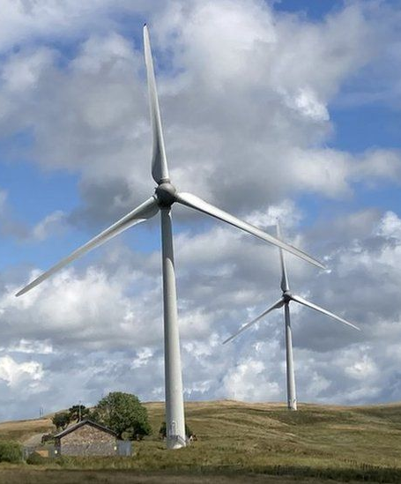
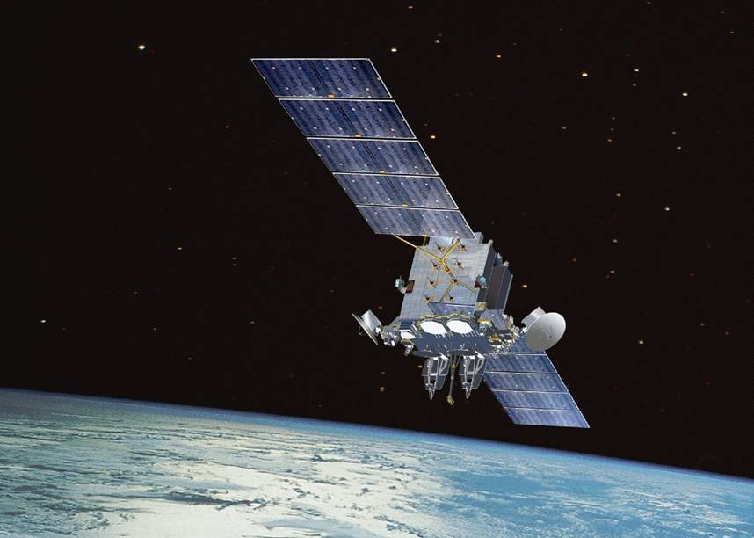
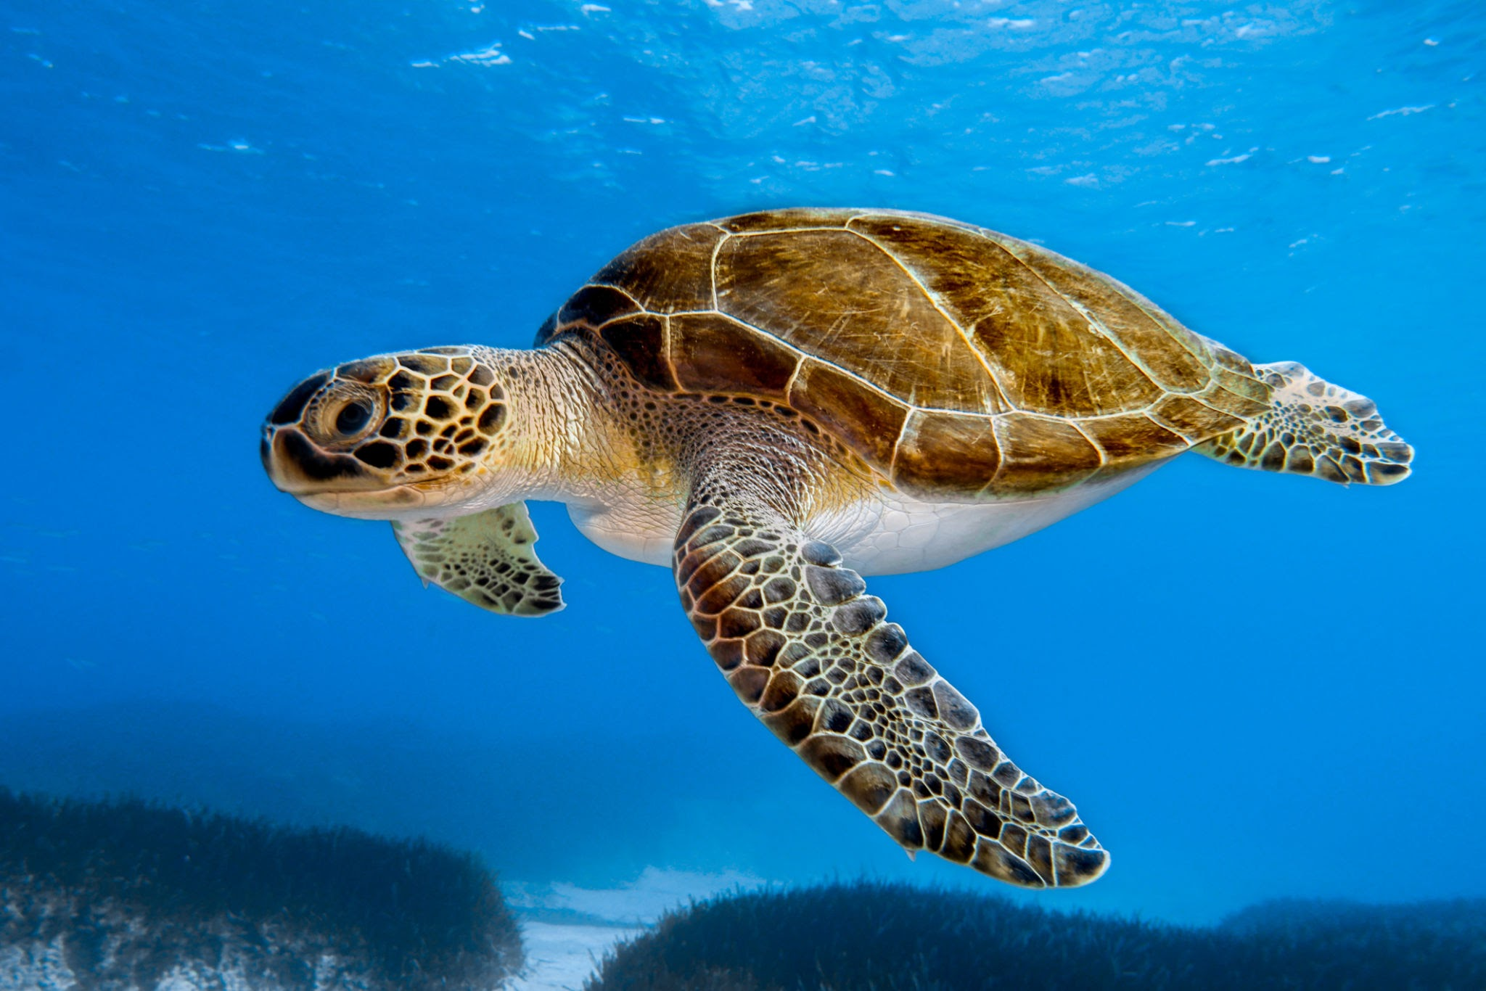
How could science help us to ensure we are fulfilling this responsibility?
Notes:
Discuss and then write down the response.
Satellites - they track the environmental and climate change - give us information and the government create new initiatives based on this
Science - finding new energy sources so we are not using the non-renewable resources and the ones that are contributing to the climate change
Through Science we have gained a better understanding of the natural world and can identify any threats - his knowledge has allowed us to develop conservation strategies that help preserve ecosystems and prevent pollution.
What is the purpose of this text? ‘Genesis explores why the universe and life exists. Science explores how the universe works the way it does.’ This is not the only way Christians interpret the text, however. Many reject the idea that the purpose of the text is to give a scientific description at all. Some see the genre as poetic, requiring different methods of interpretation. Some see it as communicating a message about the nature of God the Creator rather than the mechanism of creation. They see it as a picture of a glorious Creator and wonderful creation

Slide 10
NS - Imagine someone was looking for evidence that Psalm 8 was true, what kind of actions might they expect to find among Christians? - padlet
Notes:
For example, some might worship God, or become scientists to explore creation more, or artists to express God’s creativity in their art, or farmers to care for the planet, or architects who create places of worship, or therapists to care for humans who are suffering from depression…

