Slide 1

Online Safety Presentation - Parents
St Giles CE School

Slide 2
Purpose of the presentation
To look at how the children use the internet
To raise awareness of online safety and to deepen your understanding of the impact on your children
To provide guidance on online safety and privacy for your children
To answer any questions and provide you with practical resources and strategies which you could be using at home

Slide 3
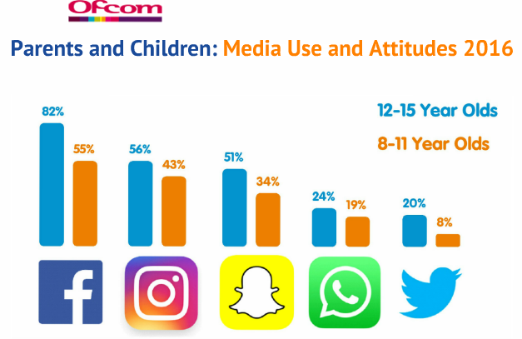

Slide 4
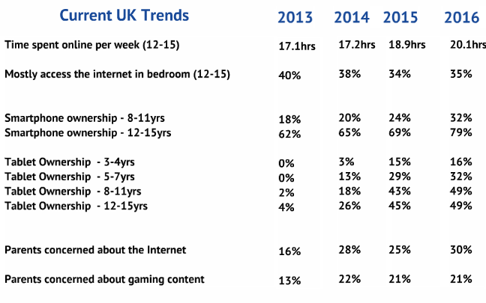
Ofcom 2016
NICOLA RUDGE –ONLINE SAFETY ADVISOR

Slide 5








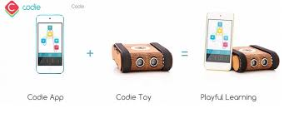



What technology do your children have access to?
Notes:
Use of technology, apps and communication devices, able to communicate, play games, etc

Slide 6

What are the online safety risks and concerns?
Grooming
Cyberbullying
Digital footprint, reputation and identity theft
Illegal and inappropriate behaviour
Inappropriate content
Too much time spent on the internet
Copyright and illegal downloads

Slide 7



Gaming issues
Have you checked the PEGI rating?
Pan European Game Information
NICOLA RUDGE –ONLINE SAFETY ADVISOR

Slide 8


Digital Footprint Digital Tattoo
Whenever we go online, we leave a digital footprint which forms our digital tattoo
Everything is stored somewhere
You have no control once it’s online
It cannot be deleted
Anyone can find out about you
Are you happy for anyone to see everything about you?
How does it affect your reputation?
Who might use this information?

Slide 9
Key Online safety practices

Slide 10
Sharing personal information
Not everything is true – gullibility
People lie frequently
Personal information
Use nickname
NICOLA RUDGE –ONLINE SAFETY ADVISOR

Slide 11

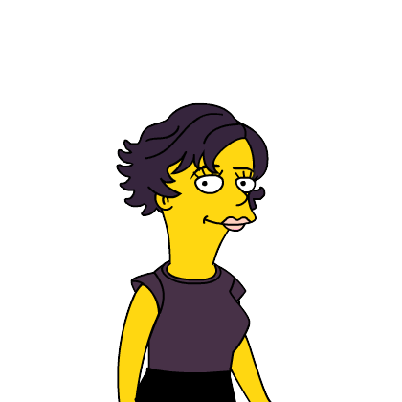
Pictures/VIDEOS
Ask permission before taking and sharing
Encourage to take not in school uniform
Must be fully dressed
Be careful what is behind you in photos and videos
NICOLA RUDGE –ONLINE SAFETY ADVISOR
Notes:
For ever is a very long time
I use an avatar for my picture when I need one.
You can use a picture you have drawn or a piece of clip art if you really want an image.

Slide 12


Passwords
Check password security
Never “password” or similar
Long enough
Not written down
For example I went on holiday to Devon in 1983. The password could be “D1e9v8o3n!?.”
NICOLA RUDGE –ONLINE SAFETY ADVISOR

Slide 13
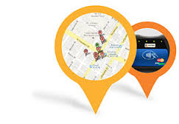
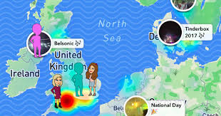
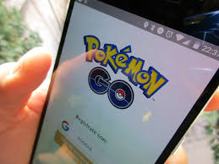
Time and a Place
Carefully consider whether to use geolocation on social networks/games
Be careful “checking in”
Check privacy settings
Ask for permission before using any geolocation
NICOLA RUDGE –ONLINE SAFETY ADVISOR
Notes:
Insurance company checks

Slide 14

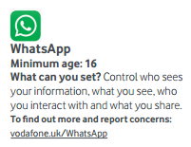
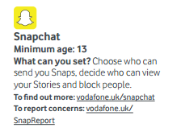
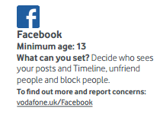
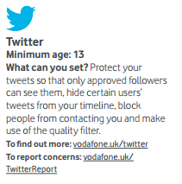
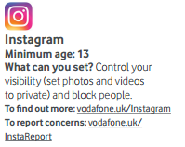
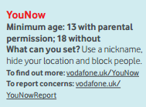
Social media
What are the minimum ages?
How do you know?
NICOLA RUDGE –ONLINE SAFETY ADVISOR
Notes:
Not law in this country but is a good guide for parents

Slide 15
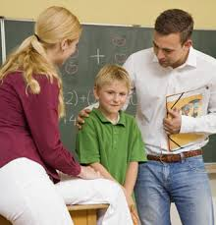
Parental support
Keep devices in a common area of the house
Monitoring what young people are doing
Clear settings for inappropriate content and purchases
Consider using less time on the Internet
Keep open dialogue with young people
NICOLA RUDGE –ONLINE SAFETY ADVISOR
Notes:
Home Halo – monitoring and Qustodio

Slide 16

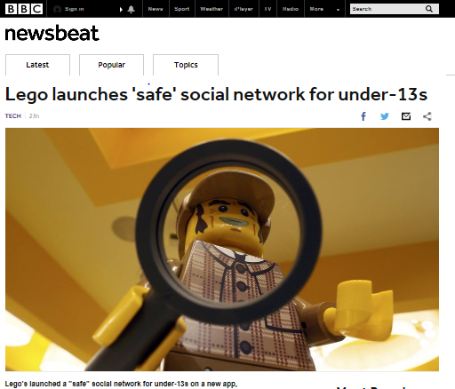
Alternative Apps

Slide 17
What are schools doing?
Have an acceptable use policy.. Should be signed by pupils, parents and teachers
A detailed and comprehensive filtering and monitoring system to monitor internet use in school on regular basis
A curriculum which teaches online safety
Posters and displays
Parents information
Clear system for reporting incidents and concerns for children and staff
Safer Internet Day
Regular staff training

Slide 18
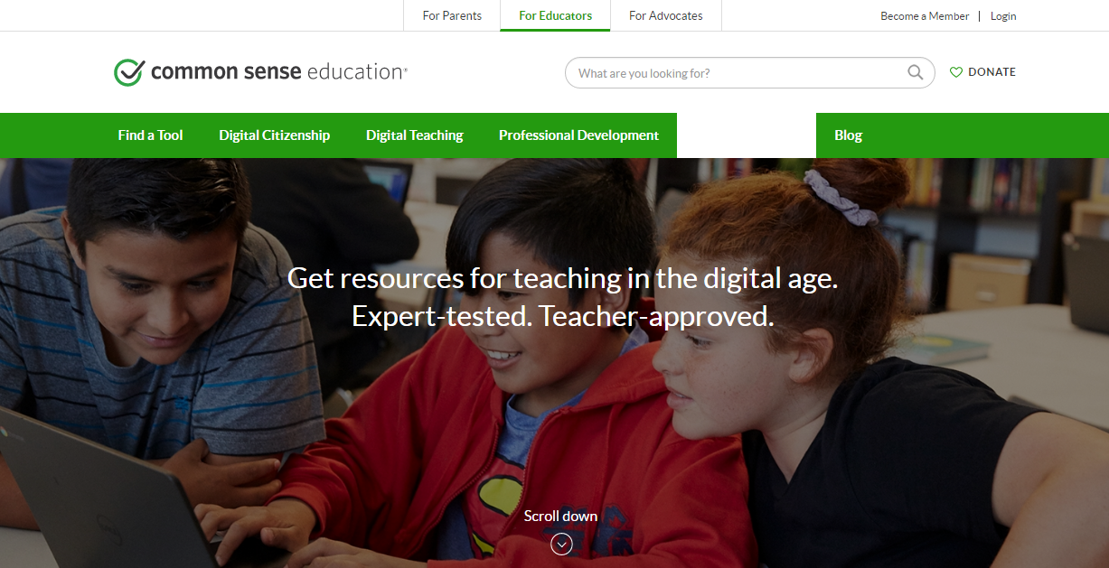
Common sense media- https://www.commonsensemedia.org/
NICOLA RUDGE –ONLINE SAFETY ADVISOR

Slide 19
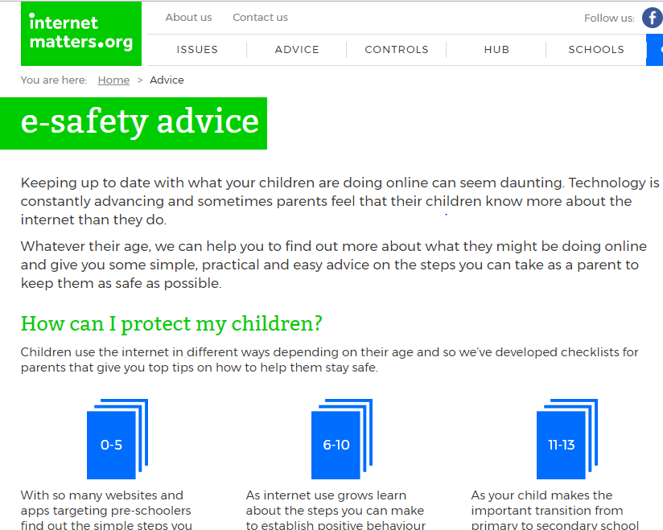

Internet Matters - https://www.internetmatters.org
NICOLA RUDGE –ONLINE SAFETY ADVISOR

Slide 20




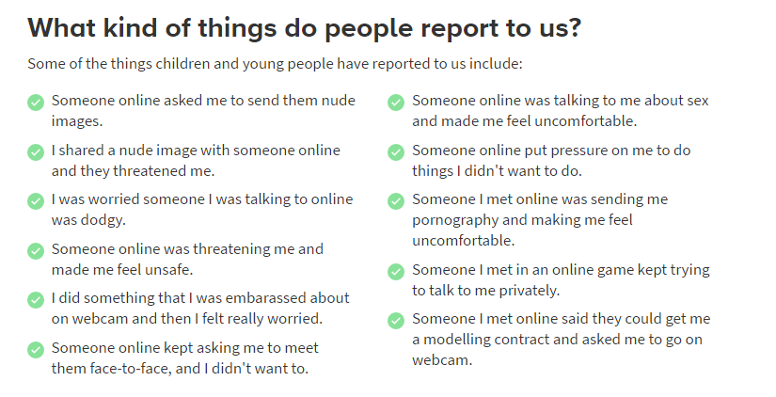

Child Exploitation and Online Protection Command
NICOLA RUDGE –ONLINE SAFETY ADVISOR
Notes:
If you feel that there is something you really can’t tell any adults you know there are other options.
Childline is a safe and secure place to talk to trusted adults about anything that is worrying you.
You will notice on a lot of websites an eye logo. This is where you can click if you think there is something to report on the site.

Slide 21

KEY POINTS
Remember to highlight the positives
Think carefully before you react
Recognise young people use the internet differently
Talk

Slide 22

Questions…

