Slide 1


Moving from Nursery to Reception
Supporting Your Child

Slide 2

Welcome to the School Nursing Service
School Nurses are qualified nurses who
have additional training in child health and
wellbeing.
They work in a team with staff nurses,
nursery nurses, support workers and
administrative staff
The School Nursing Team support children and young people from reception
age up until their 19th birthday. Young people who have disabilities or additional
needs can access support until they are 25 years old.
The team provide advice, support and help with a range of physical and mental health
problems

Slide 3

How to access the School Nursing Service
We operate a Single Point of Access
We work Monday to Friday 9am-5pm
Call: 01922 423349
Text: 07520 634 909
We offer confidential advice and support.
Our text service allows parents/carers to contact us anonymously

Slide 4











Are you ready for your child to start full time school?
Your child starting full time school can be a time of mixed emotions for you and your childhild
I will miss my parents/carers
Will the teacher be nice to me?
Anxious
Will they cope being there all day?
Will I see my nursery friends
What will I have for lunch?
I’m excited to stay all day
I’m a big kid now
Will they miss me and get upset?
Notes:
When it is time for your child to move to full time school it can be both exciting and a worrying time for you, as a parents/carer and for your child and you and your child will feel a mixture of emotions.
ASK if anybody would like to share what they are feeling and discuss briefly
You may feel nervous, anxious, worried, excited, happy. Your child may be having these feelings also.
Some of the things you may be thinking : (bring up captions)
Will they make friends
They will love it, I cant wait
They are growing up
Will they cope being there all day
Will they miss me and be upset
Some of the things your child may be feeling: (bring up captions)
I’m going to miss my parents/carers
Will the teacher be nice to me
What will I have for lunch
Will I still see my friends from nursery
Im excited to stay all day
Im a big kid now

Slide 5
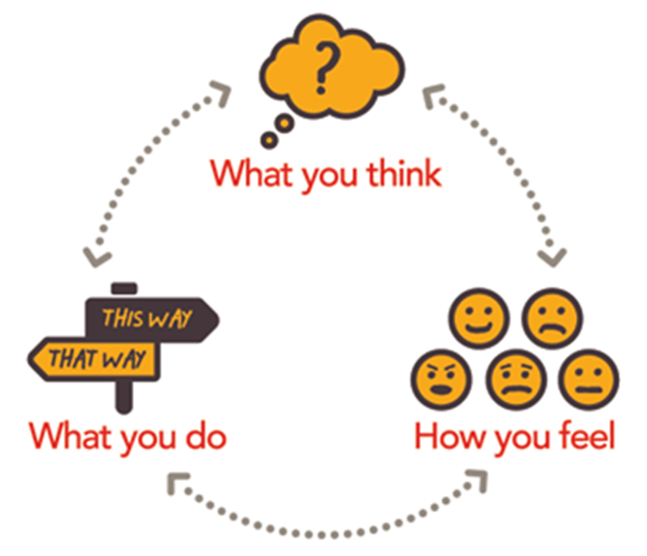
Think – Act – DO cycle
The think, act, do cycle shows us how what we think will affect how we feel, which affects what we do (our behaviours).
Our behaviour will then affect how we think and the cycle will continue.
REMEMBER
Children are like sponges and will pick up on and copy emotions and behaviours of others
Notes:
The Think, act, do cycle looks at how our thoughts will guide how we feel. This will then effect what we do – as in how we behave.
How we behave will then again effect how we think and the cycle continues.
Example –
You think your child will be very upset and miss you when they start school
You feel anxious, worried, sad
You may be emotional, cry or discuss your fears with others and ask your child how they are feeling about school, which feeds into your worrying thoughts and the cycle continues.
This is normal as a parent/carer to experience.
Psychology tells us that we are driven by our dominant thoughts, so if our dominant thoughts around starting full time school are fearful and we focus on them missing us and being upset, we will naturally look for evidence to support those negative thoughts and be less likely to change to a more positive outlook.
Children will pick up on any tension or conflict in the adults around them, even though they may not understand the language used, or they appear not to be listening. It is important to monitor our thought processes and regulate our emotional responses to the upcoming change.

Slide 6




Top tips for parents
HEALTH
Healthy diet.
Enough sleep.
Exercise.
Prepare & plan.
Emotional health
CALM
Try to stay calm when your child is feeling distressed or over excited.
ANCHOR
In times of change remember you provide them stability and routine
BE PREPARED
Prepare yourself and your child as much as you can before school starts.
Notes:
There are a number of things you can do to support your child and yourselves, through the transition to full time school.
HEALTH - You know your child best; what makes them happy, grumpy, hyper, deflated.
Encourage healthy diet.
Do they normally need lots of sleep? They will be more tired once they start school and this may make affect their
behaviour. Ensure they get adequate sleep
Do they need alone time?
Do they have a medical condition?
You can help your child by making sure that they get enough rest, exercise, a healthy diet and time to be alone if they need it. Plan ahead with school for medical conditions – schools will support your childs health needs and care plans can be put in place. Reassure your child that this will be happening and they will be supported. Support your child in understanding and identifying their own emotions and to normalise them, and also to have an awareness of other peoples emotions.
CALM - Try to stay calm when your child is feeling distressed or over excited. Your child may :
Have highs and lows
Get angry
be very self-centred
Be melodramatic
Over excitable and hyper
Your child will learn from your responses and behaviours, if you remain calm this will impact on your child and provide them with a safe space for them to express how they are feeling. Remember the think act do cycle and to self regulate your own emotions and feelings.
ANCHOR - During times of change you will be the anchor for them. For your child you are:
Familiar, routine, a guide, constant, comfort, irritating, home, provide boundaries
Listen to your child and give reassurance . Listen to their point of view.
BE PREPARED -
Prepare yourself and your child as much as possible before school starts.
Sign up to any school apps/portals/emails. These will give you information about events to put in your diary, your childs progress etc. Practice the journey to school with them – Familiarise them of the route.
Get them used to the routine of getting up, washed and dressed and ready to leave the house in time for school.
Go through the school checklist with your child to make sure they have everything they need.
Meet the teacher / see the school and classroom in advance. Attend open days/evenings
Enquire about any financial support you may be entitled to – ie free school meals, grants. Speak to the school and they can advise you.
INDEPENDENCE
Help your child to move from identifying as a child to a teenage identity in a positive way. Increase their responsibilities and allow more independence (age & development appropriate). Notice and praise when they are acting mature and encourage this.
Be mindful that your childs need are changing and will fluctuate. It may feel like you are taking one step forward and two steps back at times.
As your child is going to be starting to take on more responsibilities, promoting more independence in relation to their own health is also an important step. This can include things such as them having to remember to maintain their personal hygiene, if they have any medical conditions, to become more responsible for managing this. Encourage and support your child to
Make decisions on their health and wellbeing
Access support for their health and wellbeing
There are a number of resources your children can use to access latest, research based advice and support regarding their health which we will discuss at the end of the presentation.

Slide 7




Top tips for parents
INDEPENDENCE
Increase responsibilities.
Notice and praise independence
SELF CARE
Eat well.
Exercise.
Relax.
Seek support
HAVE FUN
Provide lots of light relief and fun with your child.
Have fun with them.
COMMUNICATION
Communicate with your child.
Nurture their communication skills.
Communicate with school
Notes:
INDEPENDENCE
A large part of starting full time school is your child becoming more independent and is an important step in their development . Before September, increase their responsibilities and allow more independence (age & development appropriate). Notice and praise when they are trying new skills. We will look at life skills in the next slide.
Be mindful that your childs need are changing and will fluctuate. It may feel like you are taking one step forward and two steps back at times.
SELF CARE - In order to support your child through this transition you must make sure that you look after yourself also.
Eat a healthy diet
Get plenty of exercise
Take time to relax and make time for yourself to do the things you enjoy
Seek support from others – family members, friends, partners, other parents. Talk about your concerns about transition and get advice and support. Get in touch with the school/teachers to ask any questions you may have or share your concerns.
HAVE FUN – provide lots of light relief and have fun with your child
During a stressful time it is important to make sure that you and your child have some fun. Be silly, play games, make things together, have a giggle, do activities you both enjoy together. This will provide some balance and relief from the worry about the big change ahead.
COMMUNICATION - Good communication will give your child the skills to be able to express themselves clearly and confidentially in all aspects of their life. If your child is able to communicate to you their thoughts, feelings, wishes, beliefs and needs it will impact positively on their lives. Communication is two ways, so ensure you communicate with your child also.
Communication comes in many forms:
Talking
Listening
Hearing
Hugging
Smiling
Sympathising
Reassuring
Sharing
Checking
Suggesting
Communicate regularly with school – as well as listening to the worries and voice of the child, you can discuss any worries, anxieties or you may have about them starting school. This can help allay your fears, or help address and put plans in place to address issues.

Slide 8

Life Skills that will help your child in full time school
Toileting and hygiene
Meal time skills
Dressing
Making friends
Listening and talking (conversation)
Play and sharing
Notes:
Equipping your kids with some practical skills will help them feel happy and confident about starting primary school and will also reassure you that the transition will be easier because of these skills.
(bring each skill up individually and discuss)
Toileting & hygiene
- happy to use toilet on their own
- confident and able to ask when they need the toilet
- Handwashing
- Able to take off their trousers/tights/underwear easy enough to use the toilet
- Expect a few accidents whilst they are settling in, this is normal.
- Washing and brushing their teeth under supervision.
Meal time skills - ensure they can open their own cartons/drinks/wrapping on foods and packets
- Get them used to sitting at a table for a meal (usually 30 mins) without getting up and down
- Use of cutlery
Dressing – Practice putting their uniform on
- Make a game out of putting uniform on and changing into PE kit. You will pick up on areas they have
difficulty with so they can practice.
- Make this fun and praise efforts as well as results.
Making friends - provide opportunities for your child to make friends – ie playgroups
- encourage making friends with others – support and reassure if they find this difficult.
Listening and talking – talk to your child regularly
- take an interest in what your child is telling you and engage in conversations with them.
- listen to your child and encourage them to do the same – be realistic in your expectations.
- Read regularly with your child – they will be read to at school and need to be able to sit and listen.
Play and sharing - Encourage them to take an interest in the world around them, and to want to do things for themselves.
- Support them and teach them to share and take turns.
Children develop at their own pace and as long as parents and carer’s are supporting them in their effort towards responsible self-care and self-regulation, that is the best that can be done. Your child will be ready in their own time with the right support and encouragement.

Slide 9
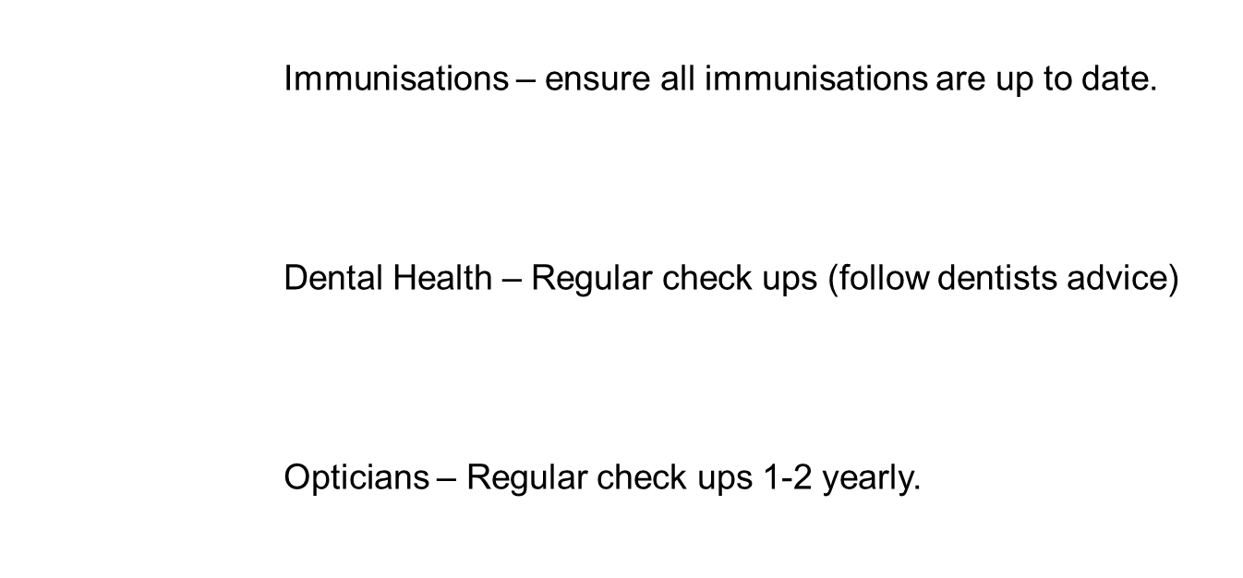



Health Checklist
Notes:
Health is important at all stages of life, but during transition it is essential as the child’s environment is changing.
IMMUNISATIONS
We need to ensure that all immunisations are up to date – you can ask your GP if you are unsure if your child is up to date.
Dental hygiene – Poor dental hygiene can cause decay and tooth loss which may make your child insecure about their appearance.
It also causes pain which can result in time off school or sleepless nights which will impact on their education. This can be very unsettling when they have just started a new school.
Dental care is free for under 16’s and those under 19 if in full time education and advice should be followed by your dentist for how often dental checks are required.
Opticians – Regular appointments are needed to make sure your eyes stay healthy – follow opticians advice for how regular they need them. If your child is having trouble with their vision this can create problems including headaches, blurred vision, inability to concentrate at school, difficulty seeing boards in class.
Eye sight tests are free for children under 16 years and children under 18years who are in full time education.

Slide 10

Positivity is Key
Focus on your child’s strengths
Be positive and enthusiastic
Praise and support
Believe in yourself and your child
Notes:
Focus on your childs strengths
There can be a tendency to start to think about what a child might or does struggle with e.g. is not good at making friends, at sharing, at deciding when to go to the toilet, etc. Using the think – act – do cycle regulate your thoughts and focus on what your child can do.
Be positive and enthusiastic
Keep positive and enthusiastic and regularly discuss all the fun and new things they will be doing at their new school.
Praise and support
Include you child by making a visual and fun exercise, using a home-made or a chart bought from a stationery shop. Encourage your child to be aware of when they have mastered new skills and add these to the chart, giving praise frequently and lavishly for effort and achievement.
Believe in yourself and your child
Parents may feel acutely conscious of the perceived judgement of others. The start of the school term is rife with opportunities for generating insecurities in parents. The spoken or unspoken views of other parents, of teachers, teaching assistants, lunch-time supervisors, all may suddenly seem to matter and take on a significance that can be frightening. Be conscious of those times when our own assessment of our child’s strength and difficulties, may be influenced by the perceived judgement of others. Do not allow your confidence in your child to be under-mined. Most importantly, do not allow your love for your child to be under-mined by doubt and insecurities.
Children can have certain needs and/or experience difficulties. Children are usually not perfect in all areas? Remember that the difficulty does not define your child. Try to keep the focus small, so that it does not dominate the language you use around and about your child. E.g. the child who may not be adept at dressing themselves or going to the toilet in time, may be the most caring and considerate to others. In this instance, the child’s social competences (or Personal, Social and Emotional Development) have over-taken Parents may feel acutely conscious of the perceived judgement of others. The start of the school term is rife with opportunities for generating insecurities in parents. The spoken or unspoken views of other parents, of teachers, teaching assistants, lunch-time supervisors, all may suddenly seem to matter and take on a significance that can be frightening. Be conscious of those times when our own assessment of our child’s strength and difficulties, may be influenced by the perceived judgement of others. Do not allow your confidence in your child to be under-mined. Most importantly, do not allow your love for your child to be under-mined by doubt and insecurities.

Slide 11




Where to go for advice/support?
Too ill to go to school?
https://www.nhs.uk/live-well/healthy-body/is-my-child-too-ill-for-school/.
Stay Well Walsall:
https://walsallccg.nhs.uk/stay-well-walsall/nhs-services
School Nurse Single Point of Access
Monday to Friday 9am-5pm
Call: 01922 423349
Text: 07520 634 909
Visit our website:
www.healthforkids.co.uk

Slide 12



